Slide 1
.Net Programming
Ngo Lam Trung
School of Information and Communication Technology
Office: 505-B1
E-mail: trungnl@soict.hust.edu.vn

Slide 2
Course content
Basic of .Net with samples in C#
  Data types,
Advanced programing topics in .Net
  Garbage collector, Async/Await,…
➔ Students are required to study the topic of each class in advance

Slide 3
Course evaluation
NOTE: final exam on PC (not group project)
A single exam will replace both mid-term and final exams
➔ Students need to understand the lectures in order to pass the exam

Slide 4
References
Microsoft .Net Guide: https://docs.microsoft.com/en-us/dotnet/standard/index
https://docs.microsoft.com/en-us/dotnet/framework/development-guide
Andrew Troelsen, Philip Japikse, C# 6.0 and the .Net 4.6 Framework, 7th edition.
Ben Watson, Writing High Performance .Net Code, v1.4, 2014.

Slide 5
Week 1: Introduction
Introduction of .Net, C#
Setting up working environment
Some first samples
Topic for next class

Slide 6
Introduction of .Net
The Microsoft .NET Framework is a software component that can be added to or is included with the Microsoft Windows operating system.
It provides a large body of pre-coded solutions to common program requirements, and manages the execution of programs written specifically for the framework.
The .NET Framework is a key Microsoft offering, and is intended to be used by most new applications created for the Windows platform.

Slide 7
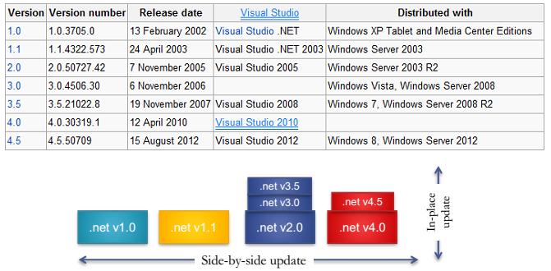
History

Slide 8
Design goals and principal features
Interoperability - the .NET Framework provides means to access functionality that is implemented in programs that execute outside the .NET environment.
Security - .NET allows for code to be run with different trust levels
Simplified Deployment - the .NET framework includes design features and tools that help address these requirements.

Slide 9
Common Runtime Engine - Programming languages on the .NET Framework compile into an intermediate language known as the Common Intermediate Language, or CIL;
Microsoft's implementation of CIL is known as Microsoft Intermediate Language, or MSIL.
This intermediate language is compiled in with just-in-time compilation (JIT) into native code.
The combination of these concepts is called the Common Language Infrastructure (CLI)
Microsoft's implementation of the CLI is known as the Common Language Runtime (CLR).

Slide 10
Language Independence - The .NET Framework introduces a Common Type System, or CTS.
The CTS defines all possible datatypes and programming constructs supported by the CLR.
  ➔ the .NET Framework supports development in multiple programming languages
Base Class Library - BCL is a library of types available to all languages using the .NET Framework.

Slide 11
platform independence
A design goal of the .NET Framework is to support platform independence. That is, a program written to use the framework should run without change on any type of computer for which the framework is implemented.
However, Microsoft has only implemented the full .NET framework on the Windows operating system.
Microsoft and others have implemented portions of the framework on non-Windows systems, but to date these implementations are neither complete nor widely used, so cross-platform support is not yet fully achieved.

Slide 12
NET Framework architecture
Common Language Infrastructure (CLI)
Assemblies
Metadata
Base Class Library (BCL)

Slide 13
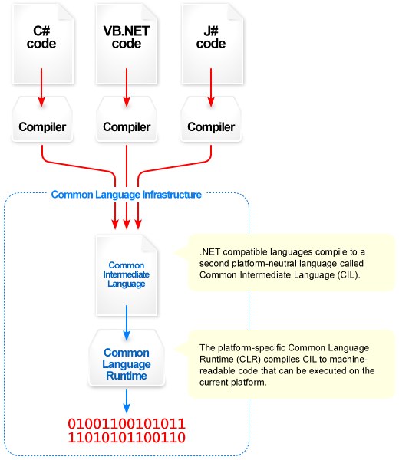
Common Language Infrastructure (CLI)

Slide 14
CLR
Programs written for the .NET Framework execute in a software environment that manages the program's runtime requirements.
This runtime environment, which is also a part of the .NET Framework, is known as the Common Language Runtime (CLR).
The CLR provides the appearance of an application virtual machine, so that programmers need not consider the capabilities of the specific CPU that will execute the program.
The CLR also provides other important services such as security mechanisms, memory management, and exception handling.
The class library and the CLR together compose the .NET Framework.

Slide 15
Microsoft's implementation of the CLI is called the Common Language Runtime, or CLR. The CLR is composed of four primary parts:
Common Type System (CTS)
Common Language Specification (CLS)
Just-In-Time Compiler (JIT)
Virtual Execution System (VES)

Slide 16
Common Type System (CTS)
The Common Type System (CTS) is used by every language built on the .NET Framework.
A fundamental part of the .NET Framework is Common Language Runtime (CLR),
the CTS specifies no particular syntax or keywords, but instead defines a common set of types that can be used with many different language syntaxes.
Each language is free to define any syntax it wishes, but if that language is built on the CLR, it will use at least some of the types defined by the CTS.
While the creator of a CLR-based language is free to implement only a subset of the types defined by the CTS. Visual Basic.NET, C#, and pretty much every other language used with the .NET Framework rely heavily on the CTS.

Slide 17
The CTS provides every language running on the .NET platform with a base set of data types.
While the CTS is responsible for defining the types that can be used across the .NET languages, most languages choose to implement aliases to those types.
A four-byte integer value is represented by the CTS type System.Int32.
C# defines an alias for this type called int.

Slide 18
The Common Language Infrastructure (CLI) is an open specification developed by Microsoft that describes the executable code and runtime environment that form the core of the Microsoft .NET Framework.
The specification defines an environment that allows multiple high-level languages to be used on different computer platforms without being rewritten for specific architectures.

Slide 19
Among other things CLI specification describes the following four aspects:
The Common Type System (CTS)
  A set of types and operations that are shared by all CTS-compliant programming languages.
Metadata
  Information about program structure is language-agnostic, so that it can be referenced between languages and tools, making it easy to work with code written in a language you are not using.
Common Language Specification (CLS)
  A set of base rules to which any language targeting the CLI should conform in order to interoperate with other CLS-compliant languages.
Virtual Execution System (VES)
  The VES loads and executes CLI-compatible programs, using the metadata to combine separately generated pieces of code at runtime.

Slide 20
just-in-time compilation (JIT)
In computing, just-in-time compilation (JIT), also known as dynamic translation, is a technique for improving the runtime performance of a computer program.
It converts, at runtime, code from one format into another, for example bytecode into native machine code.
The performance improvement originates from caching the results of translating blocks of code, and not simply evaluating each line or operand separately (see Interpreted language), or compiling the code at development time.
JIT builds upon two earlier ideas in run-time environments: bytecode compilation and dynamic compilation

Slide 21
In a bytecode-compiled system, source code is translated to an intermediate representation known as bytecode. Bytecode is not the machine code for any particular computer, and may be portable among computer architectures. The bytecode is then interpreted, or run on a virtual machine.
A dynamic compilation environment is one in which the compiler can be used during execution. For instance, most Common Lisp systems have a compile function which can compile new functions created during the run. While advantageous in interactive debugging, dynamic compilation is less useful in a hands-off deployed system.

Slide 22
In a JIT environment, bytecode compilation is the first step, reducing source code to a portable and optimizable intermediate representation.
The bytecode is deployed onto the target system.
When code is executed, the runtime environment's compiler translates it into native machine code.
This can be done per-file, per-function or even on any arbitrary code fragment; code can be compiled when it is about to be executed (hence the name "just-in-time").

Slide 23
compilation from bytecode to machine code is much faster than from source.
The deployed bytecode is portable, unlike machine code for any given architecture.
Compilers from bytecode to machine code are easier to write, because the portable bytecode compiler has already done much of the work.

Slide 24
However, JIT may have a drawback by causing a slight delay in initial execution of an application, due to the time taken to compile the bytecode.
Sometimes this delay is called "startup time delay".
In general, the more optimization JIT performs, the better code it will generate.
However, the longer delay users will affect user experience.
Therefore a well written JIT has to make the trade-offs between the compilation time and the quality of the code it hopes to generate.

Slide 25
Other advantages of a JIT runtime include:
The compilation can be optimized to the targeted CPU and the operating system model where the application runs.
The system is able to collect statistics about how the program is actually running in the environment it is in, and it can rearrange and recompile for optimum performance.
This data is normally difficult or even impossible to obtain for conventional compilers.

Slide 26
JIT compilation is considered advantageous in many scenarios because of its portability, flexibility and performance. The only major drawback is the startup time delay

Slide 27
Virtual Execution System (VES)
The Virtual Execution System(VES) provides an environment for executing managed code.
It provides direct support for a set of built-in data types, defines a hypothetical machine with an associated machine model and state, a set of control flow constructs, and an exception handling model.
To a large extent, the purpose of the VES is to provide the support required to execute the Common Intermediate Language instruction set.

Slide 28
.NET assemblies
The intermediate MSIL code is housed in .NET assemblies, which for the Windows implementation means a Portable Executable (PE) file (EXE or DLL)
Assemblies are the .NET unit of deployment, versioning and security.
The assembly consists of one or more files, but one of these must contain the manifest, which has the metadata for the assembly.
The complete name of an assembly contains its simple text name, version number, culture and public key token; it must contain the name, but the others are optional.

Slide 29
.NET and C#
C#
  Developed specifically for .NET
  Enable programmers to migrate from C/C++ and Java easily
  Event-driven, fully OO, visual programming language
  Has IDE
  Process of rapidly creating an application using an IDE is called Rapid Application Development (RAD)

Slide 30
Working environment
Visual Studio
  Visual Studio Express/Community
  https://www.visualstudio.com/vs/community/

Slide 31
Samples
Console application

Slide 32
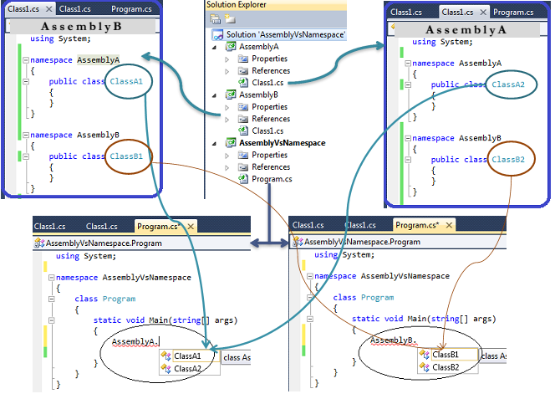
Samples
Assembly and Namespaces
An assembly provides a fundamental unit of physical code grouping.
A namespace provides a fundamental unit of logical code grouping.

Slide 34
Topic for next class
Common Type System
.Net Base Types
Type conversion
Formatting types
Manipulating strings
Parsing string
Advanced: Regular Expression

